Slide 1

Shifting Sand: How a Large DoD Project Moved Toward DevOps
Dan Gahafer,
Former DISA PM, forge.mil Program
Jeffery Payne, Chief Executive Officer, Coveros
@jefferyepayne

Slide 2







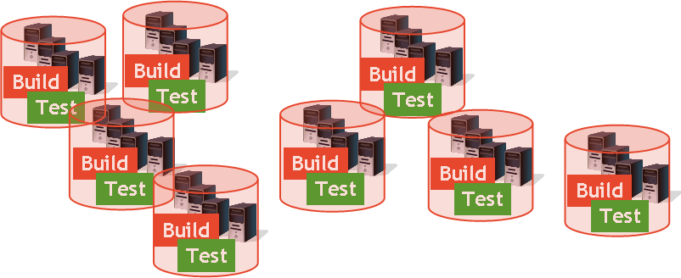



About forge.mil
Shared Asset
Libraries & Repositories
Before
Siloed development environments
Expensive and time consuming start-up
Limited exposure, sharing, or re-use
Duplication of effort
Tester
Developer
Developer
Shared Test & Development Tools/Services/Environments
Certifier
User
After FORGE.mil
Agile development and testing
Cross-program sharing: software and services
Early and continuous collaboration
Integrated approach to development life cycle
Extensible platform to support delivery of partner capabilities
Community
Collaborate
Share
Private
Notes:
Forge.mil provides an DoD wide, on-line, collaborative, agile environment for building software applications. Prior to forge.mil, software development in DoD exhibited many of the characteristics of a large, siloed organization: limited exposure, sharing, and re-use of software components and applications; expensive startup costs for new projects; and limited collaboration / communication between project teams and stakeholders.

Slide 3

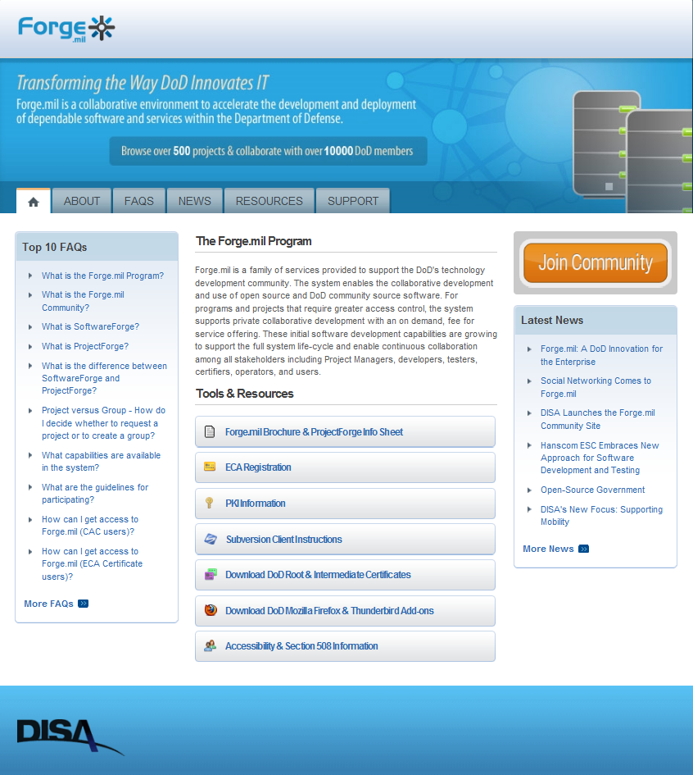
About forge.mil – By the Numbers
40,000 registered DoD developers, IT experts, and users sharing lessons learned, best practices, and solutions
900+ development efforts
Download over 2,900 software releases
Contributions include over
193,000 software commits
167,000 downloads
21,000 discussion posts
76,000 documents
7,500 wiki pages
2,300 software repositories
Notes:
Forge.mil has been a huge success within DoD! It was also considered an “exemplar project” that showed others within DoD how to do Agile and DevOps successfully.

Slide 4

In the Beginning …
there was only frAgile
Manual Deployments
Late Lifecycle Security
Manual Env Setup
Manual Deployments to Test
Manual Software Testing
(~1 month test phase)
Late Lifecycle Performance
Agile Software
Development
(2 week Sprints)
Formal Acceptance Testing
(~3-4 months release phase)
6 month release process
Notes:
Just like DoD software prior to forge.mil, the forge.mil program itself started out looking much like a traditional software development program … very fragile. Software releases took 6 months to get to the field with a significant amount of that time spend performing manual testing, manual environment provisioning, manual software installation, and manual deployments. Separation between teams (both contract and geographic separation) meant it was difficult for any one team to influence the others but the forge.mil development team decided to try and move the program toward a process that better met the needs of its stakeholders.

Slide 5

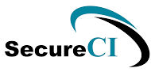
The Winds of Change
Manual Deployments
Late Lifecycle Security
Manual Deployments to Test
Manual Software Testing
Running Automated Tests
We Wrote For Them
(~1 month)
Manual Env Setup
Agile Software
Development,
Unit/Story Testing,
Continuous
Integration
(2 week Sprints)
Late Lifecycle Performance
Formal Acceptance Testing
(~3-4 months)
6 month release process
Notes:
The first improvement initiative on the program was to put in place automated continuous integration (CI) capabilities so the software was better CM’ed, tested, and integrated prior to handing it off to formal testing. As this effort was completely in the control of the development team, SecureCI was quickly setup and Jenkins jobs written to perform check-in builds, automated unit/story testing, and nightly builds to continually validate software quality and integration.
The release process was not impacted by this effort but it provided a foundation for moving more and more activities into Sprints and increasing testing/deployment automation. It also began putting pressure on downstream activities as release-quality software was now coming out of each Sprint and starting to pile up in the formal test environment and staging.

Slide 6










Continuous Integration
Manual Deployments
Late Lifecycle Security
Manual Deployments to Test
Manual Software Testing
Running Automated Tests
We Wrote For Them
(~1 month)
Manual Env Setup
Agile Software
Development,
Unit/Story Testing,
Continuous
Integration
(2 week Sprints)
Late Lifecycle Performance
Formal Acceptance Testing
(~3-4 months)
6 month release process
6 month release process
Notes:
As the formal testing team began to complain more and more about how much work we were giving them to do, the development team wrote a series of automated functional and integration tests to both run during Sprints and hand off to the test team to speed up their testing activities. Because environments were all still unique, these tests DID have to be rerun in testing to identify environmental issues. Initially test automation was done using Selenium through the User Interface as we thought this would ease the testers ability to re-run them as they were not very technical.
Unfortunately, the release process did not reduce as we later found out the team wasn’t running these automated tests as changes would often break some of them and they didn’t want to take the time to fix them so just reverted back to manual testing. By now we had a complete CI process in place performing dynamic and static analysis and dropping the resulting code into an artifact repository with release/version tags.

Slide 7

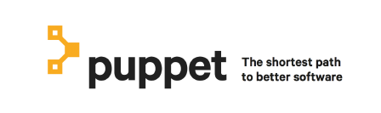
Continuous Delivery
Auto Deployments to Test
Automated Software Testing
(Performed during Sprints)
Late Lifecycle Security
Late Lifecycle Performance
Formal Acceptance Testing
(2 Months)
DevOps Team
producing release
ready code
(2 week Sprints)
2 month release process
Notes:
We decided the only way to get testing (and others) on board was to standardize all environments and automated the manual provisioning, configuring, and deployment activities.
The development team requested a copy of the procedures used to provision test, staging, and production environments as well as deployment instructions. Based upon this info, the team used puppet to automate all of the manual efforts associated with environment setups and deployments. This standardized all of the environments, significantly reducing downstream issues as well as massively speeding up the process. The release process shrank considerably as most build, test, setup, deployment could now be done during Sprints or at the end of a Sprint.
This work also allowed our team to deploy ‘releases’ within development multiple times per week, providing a more collaborative dev/test cycle.

Slide 8

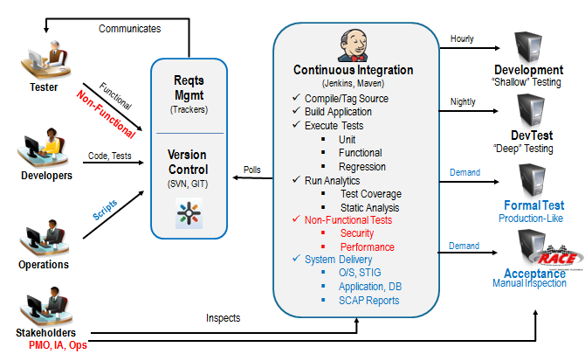





DevOps
Auto Deployments to Test
Automated Software Testing
(Performed during Sprints)
Automated Security Testing
Automated Performance
Formal Acceptance Testing
(Performed during Sprints)
DevOps Team
producing release
ready code
(2 week Sprints)
2 week release process
Notes:
After getting testing and deployment automated, we began focusing on moving security and performance earlier in the process. While there was always going to be some amount of manual acceptance testing and release authorization, we were able to get these teams to accept our scans and remediation activities once we demonstrated that we were doing them consistently in the process and they were not finding any issues downstream. Also, found lots of problems immediately including security compliance items that had never been enforced by the security team.
Performance testing was focused on assuring the software was not slowing down over time. Security testing was to make sure there would be no hiccups downstream with security and/or to identify existing vulnerabilities in libraries / frameworks before DoD issued a mandate to fix them.
This allowed our release process to be reduced down to 2 weeks.
Ultimately the team responsible for performing formal testing and deployments reduced from 15 to 2 due to automation and integrating assurance earlier in the process.

Slide 9
Results & Lessons Learned
Results
Releases reduced from 6 months to 2 weeks
Risk of release sent virtually to zero
Week long planned deployments now took hours and always worked
Full automation of functional testing
Integration of security and performance into Sprint activities
Reduction from 12-15 to 2 people needed in test and deployment
Lessons Learned
Start with things in your control
Demonstrate the power of automation and coach/train other teams after getting ‘change’ to work
Standardize environments and give all teams ‘push button’ control
DevOps is only successful when you build trust with those involved in the entire process.
Notes:
In summary, the program radically reduced its release time (and test/deployment team size) by automating test, environment setup, installation, and deployments. By starting with things in our control and demonstrating additional automation to everyone involved in the process, we were able to automate much of the process and add significant business value.

Slide 10

Questions?
Jeffery Payne
jeff.payne@coveros.com
@jefferyepayne
Dan Gahafer
dan.gahafer@gmail.com
Notes:
Thank you for your time.

